Slide 1
DATA100
Principles of Data Science
Data Collection

Slide 2
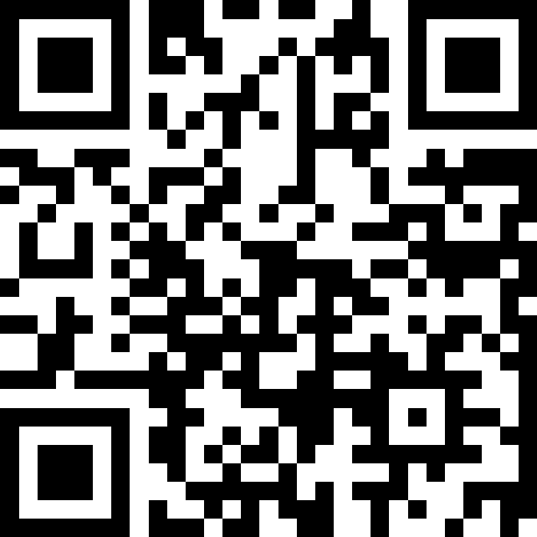
Join at slido.com
#just-somethink

Slide 3
What we’ve talked about so far...
What is data science
What are the different roles in data science
Python → our main tool of trade for working with data
numpy
pandas

Slide 4

How do you get started with a data science project?

Slide 5
Data Science Project Cycle
Problem
Start with a question that you want to answer or a problem you want to solve
Data
Maximize the potential of available data from various sources or collect your own
Explore
Understand the information embedded within the data
Learn
Use statistical models, machine learning and other data mining techniques to find patterns faster
Present
Effectively visualize and communicate the insights and knowledge derived from the data

Slide 6

Which comes first? Data or problem?

Slide 7
Types of Data Science Projects
Defined problem Unknown data | Undefined problem Unknown data
Defined problem Known data | Undefined problem Known data
Proactive
Reactive
degree of difficulty
(data size, complexity)

Slide 8
Let’s start with data!
Problem
Start with a question that you want to answer or a problem you want to solve
Data
Maximize the potential of available data from various sources or collect your own
Explore
Understand the information embedded within the data
Learn
Use statistical models, machine learning and other data mining techniques to find patterns faster
Present
Effectively visualize and communicate the insights and knowledge derived from the data

Slide 9

Big Data Management
Let the data engineers handle this!
Handling and storing big data is more complex and it’s a separate subsection in the study of data science

Slide 10
What does data look like?
With the variety of data nowadays, we need to know what types of data are out there to be able to understand them!

Slide 11
Forms of data
Structured
With identifiers
Easy searching
Examples
Relational databases
Semi-structured
With identifiers
Not relational
May be loaded into a relational database
Examples
XML
CSV
JSON
Unstructured
No labels
Raw format
Difficult for machines to process
Examples
Video
Sound
Text
PDF

Slide 12
Forms of data
Structured
With identifiers
Easy searching
Semi-structured
With identifiers
Not relational
May be loaded into a relational database
Unstructured
No labels
Raw format
Difficult for machines to process
easy
challenging
processing complexity, data size

Slide 13
Data Representation
id | firstname | lastname | age
1 | Andres | Bonifacio | 33
2 | Jose | Rizal | 40
3 | Emilio | Aguinaldo | 16

Slide 14
Data Representation
Observations → Rows represent each observation or a data point
id | firstname | lastname | age
1 | Andres | Bonifacio | 33
2 | Jose | Rizal | 40
3 | Emilio | Aguinaldo | 16

Slide 15
Data Representation
Variables → Columns represent the features of the data point
id | firstname | lastname | age
1 | Andres | Bonifacio | 33
2 | Jose | Rizal | 40
3 | Emilio | Aguinaldo | 16

Slide 16
Data Categorization Overview
Variables
Qualitative
Quantitative
Categorical
Discrete/Continuous
Nominal
Ordinal
Interval
Ratio

Slide 17
Types of Variables
Variables
Qualitative
Quantitative
Categorical
Discrete/Continuous
Nominal
Ordinal
Interval
Ratio

Slide 18
Types of Variables
Qualitative
Indicates a characteristic or quality of a variable
Usually answers what or where
Examples
Gender
Region
Country
Brand
Quantitative
Indicates an amount or quantity of a variable
Usually answers how much or how many
Examples
Age
Height
Price
Distance

Slide 19
Types of Quantitative Variables
Variables
Qualitative
Quantitative
Categorical
Discrete/Continuous
Nominal
Ordinal
Interval
Ratio

Slide 20
Types of QUANTITATIVE Variables
Continuous
Possible values are infinite
Examples
Height and weight
Wind speed
Discrete
Possible values are countable
Examples
Age
Number of typhoons in a year

Slide 21
Scales of Measurement
Variables
Qualitative
Quantitative
Categorical
Discrete/Continuous
Nominal
Ordinal
Interval
Ratio

Slide 22
Scales of Measurement
Refers to a typology of the different variables used in scientific study
Also called levels of measurement or scales of measure

Slide 23

Location Data
500 km away,
10 miles away,
5 m away
latitude, longitude
village, business district, shopping center
basement, 1st floor, 2nd floor, 3rd floor ...etc

Slide 24
Nominal Scale
Categorical variables
No intrinsic ordering
Labels and categorizes data, but does not make any quantitative distinctions between different values
village, business district, shopping center

Slide 25
Ordinal Scale
Categories that are organized in an ordered sequence
Rank observations in terms of size or magnitude
Basement, 1st floor, 2nd floor, 3rd floor

Slide 26
Interval Scale
A raw score/magnitude, equal intervals between adjacent units on the scale
Difference of values are meaningful
Equal differences between numbers on scale reflect equal differences in magnitude
No absolute zero point; an arbitrary zero may exist
latitude, longitude

Slide 27
Ratio Scale
Represents a raw score/magnitude, intervals still equally sized, and differences are still meaningful
An absolute zero point exists
A ratio or division of two values is meaningful
500 km away, 10 miles away, 5 meters away

Slide 28
Which scale?
Identifying the scale of measurement is important to know what operations we can do with it.

Slide 29
Which scale
Provides | Nominal | Ordinal | Interval | Ratio
Counts / Frequency distribution | ✔ | ✔ | ✔ | ✔
Mode, median |  | ✔ | ✔ | ✔
The “order” of values is known |  | ✔ | ✔ | ✔
Can quantify the difference between each value |  |  | ✔ | ✔
Can add or subtract values |  |  | ✔ | ✔
Can multiply and divide values |  |  |  | ✔
Has “true” zero |  |  |  | ✔

Slide 30
Which scale?
Red
Blue
Green
White
Black
Yellow
Nominal Scale

Slide 31
Which scale?
September 13, 2019
January 1, 2000
May 16, 2022
June 12, 2025
Interval Scale

Slide 32
Which scale?
Pre-school
Elementary
High School
College
Graduate
Post-graduate
Ordinal Scale

Slide 33
Which scale?
10 seconds
6 days
1000 milliseconds
525,600 minutes
365 years
Ratio Scale

Slide 34
Which scale?
Extra large
Small
Medium
Extra small
Large
Ordinal Scale

Slide 35
Which scale?
10 °C
-5 °C
100 °C
37 °C
18 °C
200.5 °C
Interval Scale

Slide 36
Where can we get data?
We know what data looks like now (in a way). But where do we get these data?

Slide 37
(some) Data Sources
Collect your own
Survey
Sensors
Field observations
… and more!
Acquire
Open data websites
Website API
Data request (e.g. FOI)
Web scraping (make sure this is ethical and legal!)
… and more!

Slide 38
Big Data
↓
Big Problems
Since we’re dealing with a variety of data sources that were collected through different instruments and different purposes, this introduces unintentional bias in the data.

Slide 39
Types of Data Bias
Response or Activity bias
Selection bias
Confirmation bias
Social desirability bias
Publication bias
Data dredging bias

Slide 40
Response / Activity Bias
Content generated by humans
A small portion of people contribute to the content and their opinions and preferences cannot be used to represent the opinion of the population as a whole.
Examples
Reviews of items on Amazon and other shopping websites
Tweets on Twitter
Posts on Facebook

Slide 41
Selection Bias
Data is selected subjectively or when interested people respond to surveys
People who are most likely interested in the topic will answer the survey.
Make sure to ask what sort of sample was collected for the research.
Examples
Election polls
Climate change survey
Most surveys

Slide 42
Confirmation Bias
Occurs during data analysis where one wants to prove a predetermined assumption.
Data analysts with a goal or a predetermined conclusion are prone to this type of bias wherein they could intentionally exclude some variables from the analysis.

Slide 43
Social Desirability Bias
Tendency of survey participants to respond in a manner that may be viewed favorably
People can over-report their “good” behavior and under-report their “undesirable” behaviors
Examples
Alcohol or drug use

Slide 44
Publication Bias
Less significant results are more likely to be omitted in publication
This leads to incomplete information in the reporting of the analysis and can skew further studies

Slide 45
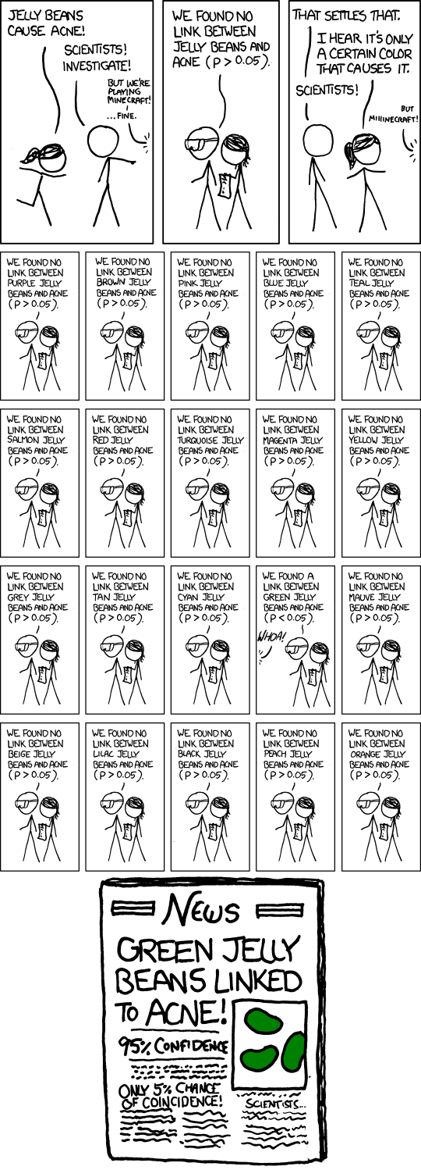
Data Dredging
Source: https://xkcd.com/882/

Slide 46
Data Dredging
“Slice your data in enough different ways and you’ll observe some correlations purely as a result of chance. Data dredging is the failure to acknowledge that the correlation was, in fact, the result of chance. Tests for statistical significance only work if you’ve defined your hypothesis up front.”
Source: Quick Data Lessons: Data Dredging

Slide 47
Questions?

